Slide 1
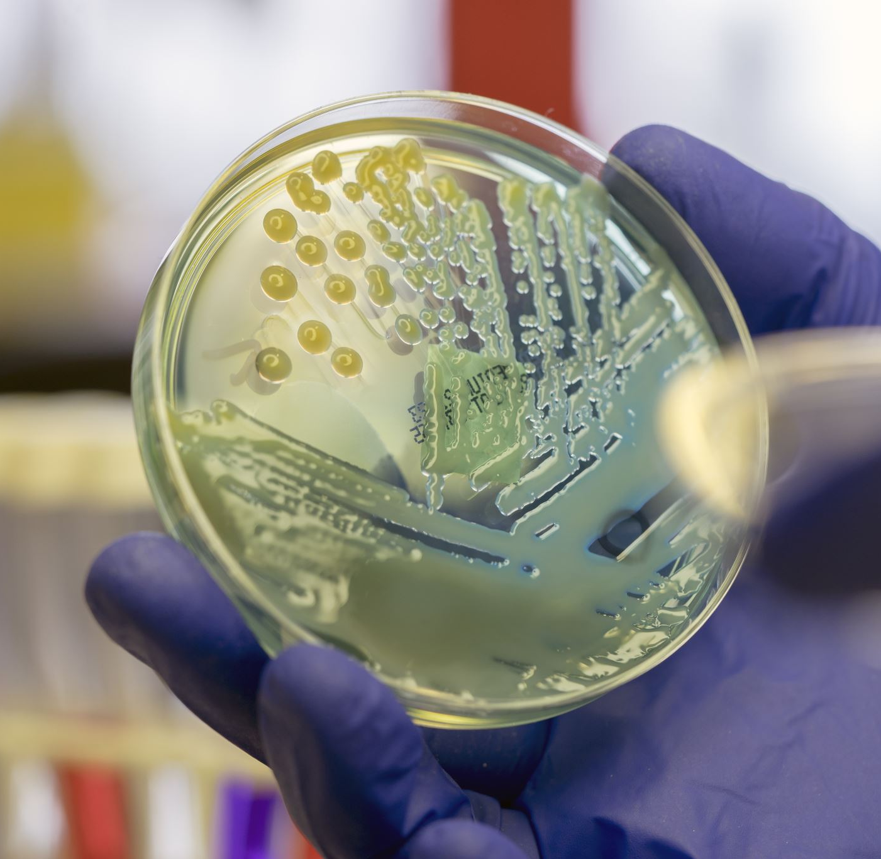
Microbial Nanoparticle Production
Bionanotechnology
BBL747

Slide 2
Introduction
Inorganic materials in the form of hard tissues are an integral part of most multicellular biological systems.
Hard tissues are generally biocomposites containing structural biomacromolecules and 60 different kinds of minerals that perform a variety of vital structural, mechanical, and physiological functions
Unicellular organisms such as bacteria and algae also are capable of synthesizing inorganic materials, both intra- and extracellularly
Examples of such organisms include magnetotactic bacteria which synthesize magnetite particles, diatoms and radiolarians that synthesize siliceous materials, and S-layer bacteria that synthesize gypsum and calcium carbonate as surface layers
These bioinorganic materials can be extremely complex both in structure and function, and also exhibit exquisite hierarchical ordering from the nanometer to macroscopic length scales which has not been achieved in laboratory-based synthesis.

Slide 3
Introduction
An important aspect of nanotechnology concerns the development of experimental procedures for the reproducible synthesis of nanomaterials of controlled size, polydispersity, chemical composition, and shape.
Though solution-based chemical methods enjoy a long history dating back to work of Faraday on the synthesis of aqueous gold colloids, increasing pressure to develop green chemistry, eco-friendly methods for nanomaterial synthesis has resulted in researchers turning to biological organisms for inspiration.
Biotechnological applications such as remediation of toxic metals have long employed microorganisms such as bacteria and yeast
The detoxification process occurring by reduction of the metal ions or by formation of insoluble complexes with the metal ion (e. g., metal sulfides) in the form of nanoparticles is known.
The possibility of using such microorganisms in the deliberate synthesis of nanomaterials is a recent phenomenon.

Slide 4
Microbial Nanoparticle Production
An amalgamation of curiosity, environmental compulsions, and conviction that nature has evolved the best processes for synthesis of inorganic materials on nano- and macro-length scales has contributed to the development of a relatively new and largely unexplored area of research based on the use of microbes in the biosynthesis of nanomaterials.
Some of the earliest reports on the accumulation of inorganic particles in microbes can be traced to the work of
Zumberg, Sigleo and Nagy (gold in Precambrian algal blooms),
Hosea and coworkers (gold in algal cells)
Beveridge and co-workers (gold in bacteria)
Aiking and co-workers (CdS in bacteria)
Reese and co-workers(CdS in yeast)
Temple and LeRoux (ZnS in sulfate-reducing bacteria)
Blakemore, Maratea and Wolfe (magnetite in bacteria)

Slide 5
Microbial Nanoparticle Production
The use of microbes in the deliberate synthesis of nanoparticles of different chemical compositions include bacteria for silver, gold, CdS, ZnS (sphalerite), magnetite, iron sulfide, yeast for PbS and CdS, and algae for gold
In all these studies, the nanoparticles are formed intracellularly, but may be released into solution by suitable treatment of the biomass.
It has been shown that fungi when challenged with aqueous metal ions lead to the formation of nanoparticles both intra- and extracellularly
Different genera of fungi have been identified for the extracellular synthesis of gold, silver, and CdS quantum dots, as well as the intracellular growth of nanocrystals of gold and silver.
Extremophilic actinomycetes such as Thermomonospora sp. have also been used to synthesize fairly monodisperse gold nanoparticles extracellularly
Yacaman and co-workers have demonstrated the growth of gold nanoparticles in sprouts, roots and stems of live alfalfa plants

Slide 6
Bacterial Nanoparticle Production
Among the different microbes studied for the biosynthesis of nanoparticles, bacteria have received the most attention
Tanja Klaus and co-workers showed that the metal-resistant bacterium, Pseudomonas stutzeri AG259 (originally isolated from a silver mine), when challenged with high concentrations of silver ions during culturing resulted in the intracellular formation of silver nanoparticles of variable shape
Transmission electron microscopy (TEM) image of a Pseudomonas stutzeri AG259 cell with silver particles located intracellularly, were crystalline, often form at the poles of the bacteria, and were not particularly monodisperse, ranging in size from a few nm to 200 nm
Most of the nanoparticles were found to be composed of elemental silver, while occasionally the formation of Ag₂S was observed
The exact mechanism leading to the formation of intracellular silver nanoparticles in P. stutzeri AG259 is yet to be elucidated.

Slide 8
Bacterial Nanoparticle Production
Biofilms of metal nanoparticles embedded in a biological matrix may have important applications in the synthesis of eco-friendly and economically viable cermet materials for optically functional thin film coatings
Jorger, Klaus and Granqvist showed that heat treatment of the Ag nano-bacteria biomass yielded hard coatings of a cermet that was resistant to mechanical scratching with a knife and whose optical properties could be tailored by varying the silver loading factor
The cermet material was composed primarily of graphitic carbon and up to 5% by weight (of the dry biomass) of silver.
In an interesting recent study, it has been demonstrated that bacteria not normally exposed to large concentrations of metal ions also may be used to grow nanoparticles
These authors showed that Lactobacillus strains present in buttermilk, when exposed to silver and gold ions, resulted in the large-scale production of nanoparticles within the bacterial cells

Slide 9
Bacterial Nanoparticle Production
The exposure of lactic acid bacteria present in the whey of buttermilk to mixtures of gold and silver ions could be used to grow nanoparticles of alloys of gold and silver
The surface plasmon vibrations from the silver and gold bacterial colloids occur at 439 and 547 nm respectively, while for the mixed alloy case it is centered at 537 nm.
In the case of bacteria exposed to a mixture of the metal ions, the fact that the plasmon vibration wavelength is within the range defined by pure silver and gold nanoparticles, together with the absence of a distinct vibration corresponding to pure silver, was argued by author to indicate the formation of an alloy of the composition Au_{0.75}Ag, and not a core-shell structure
By using a series of time-dependent UV-visible spectroscopy and TEM measurements, it was found that nucleation of the silver and gold nanoparticles occurs outside the bacterium (presumably on the cell surface through sugars and enzymes in the cell wall), following which the metal nuclei are transported into the cell where they aggregate and grow to larger-sized particles.
The presence of noble metal nanocenters is known to enhance Raman spectroscopic signatures, and this feature was used by the authors to probe the internal chemical environment in the bacteria

